Slide 1
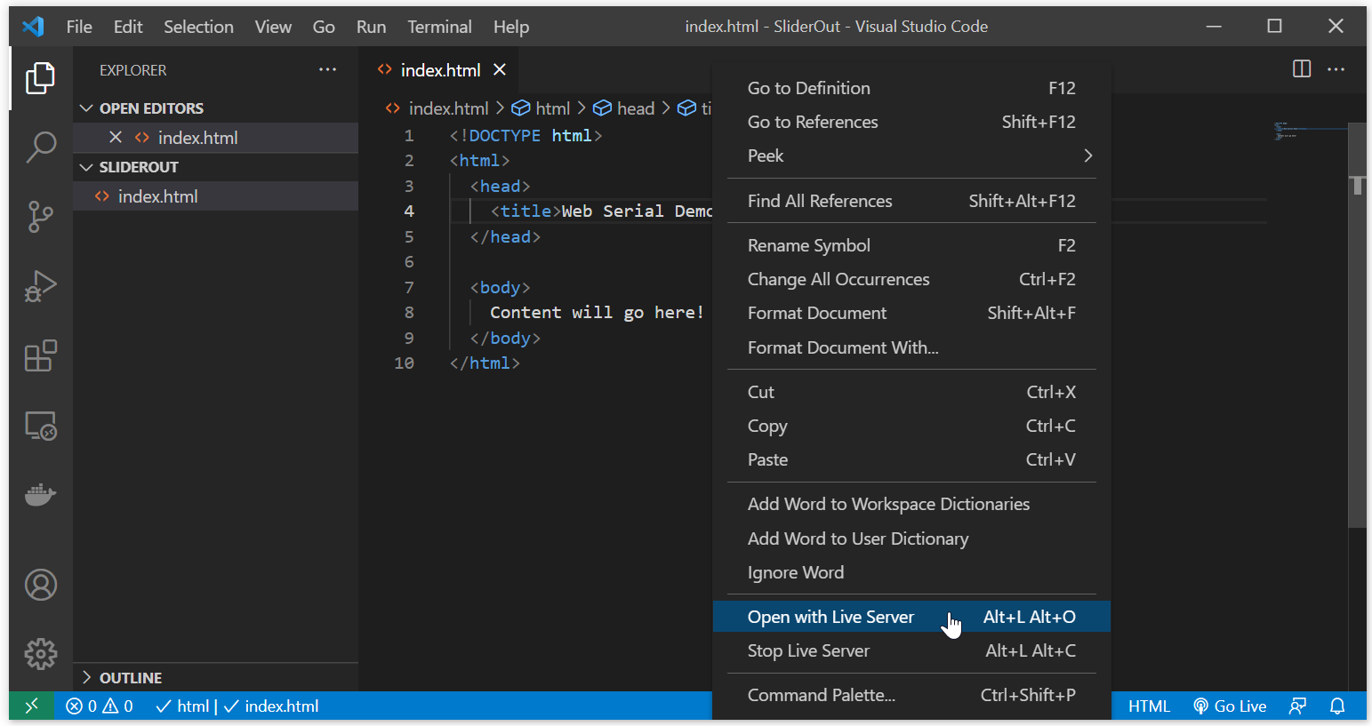
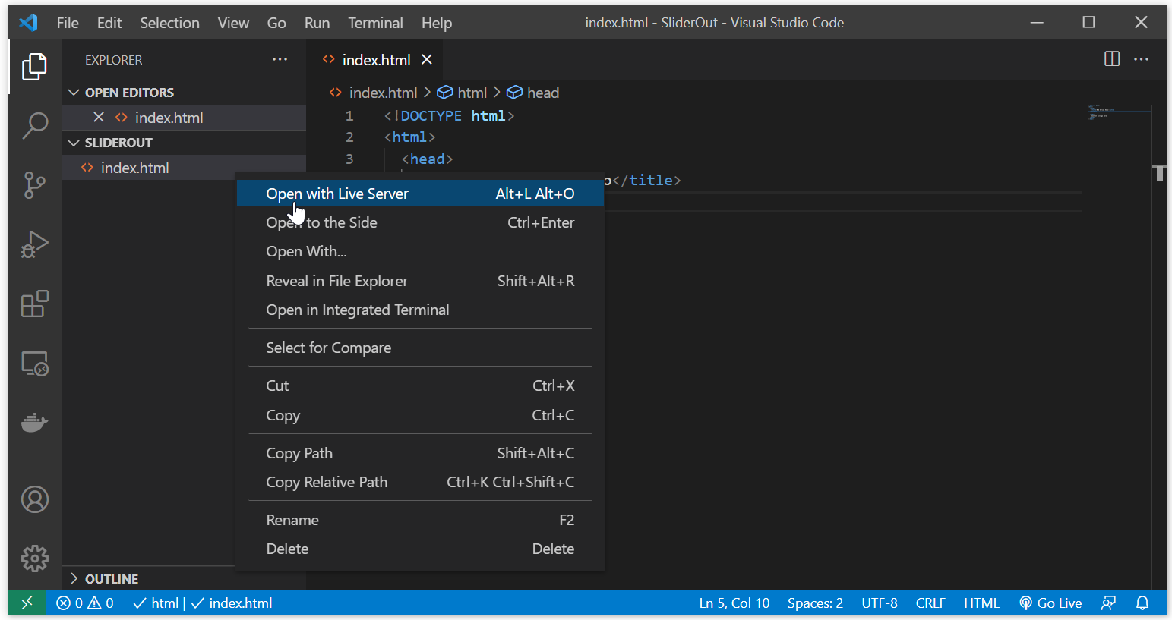

Slide 2
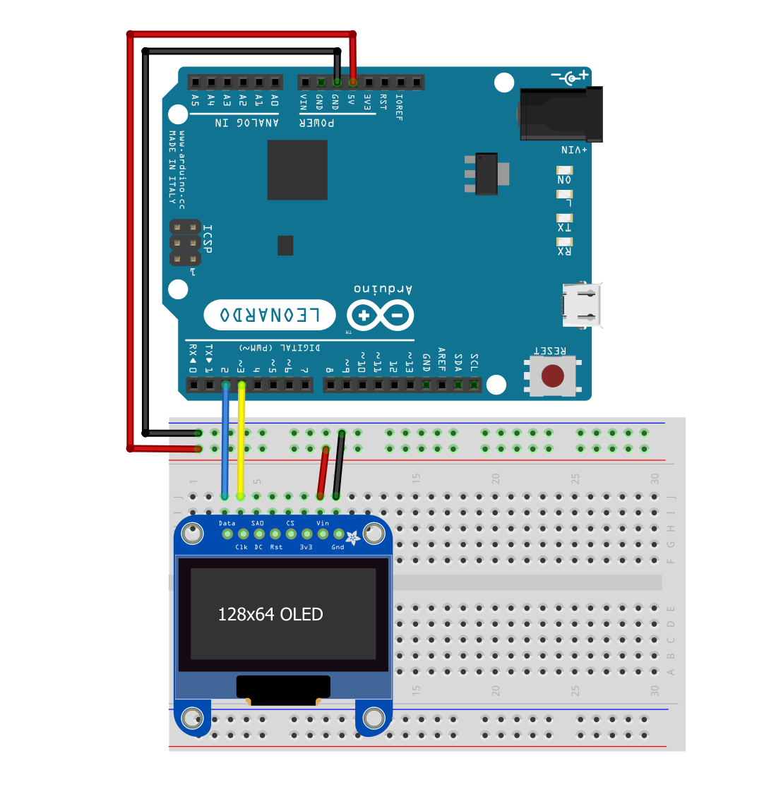
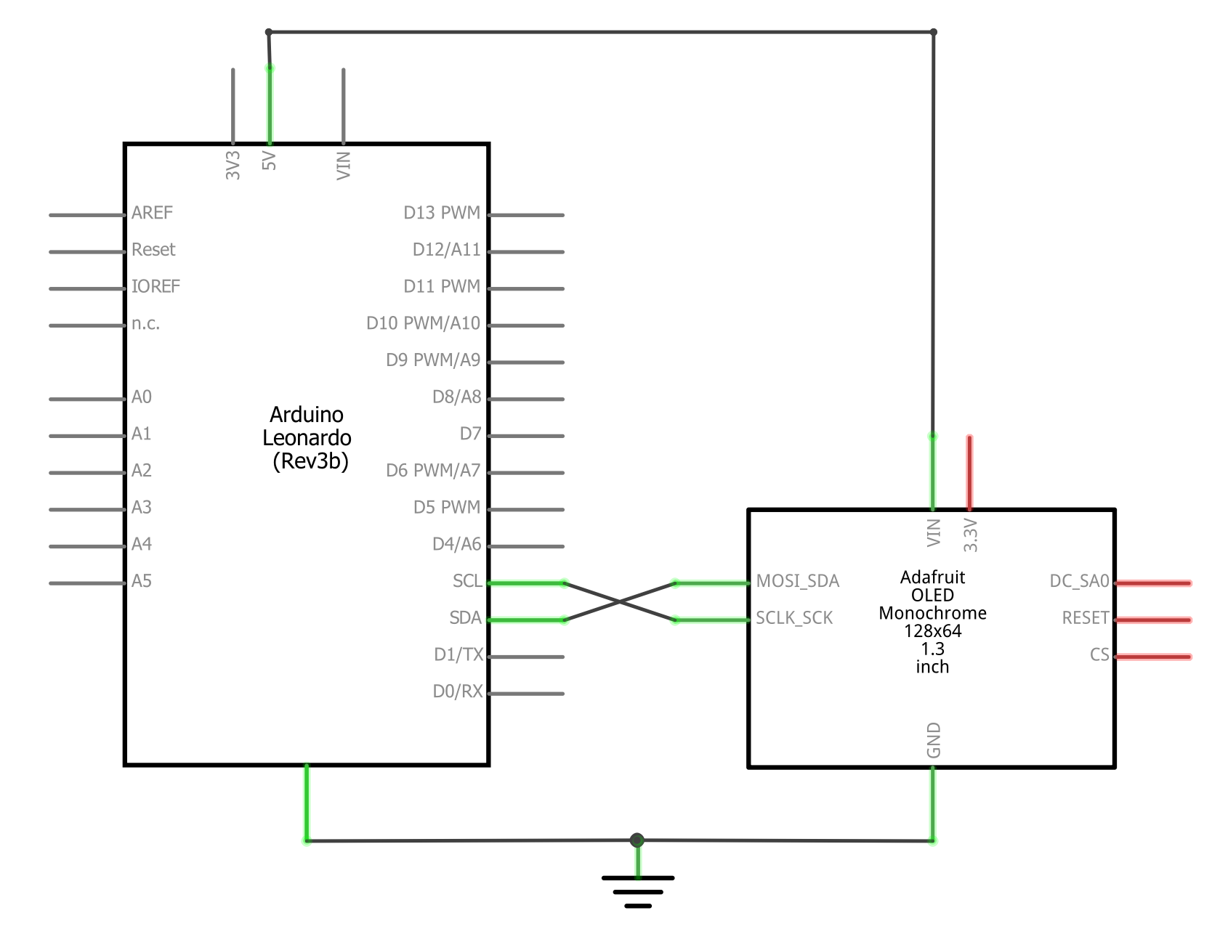

Slide 3
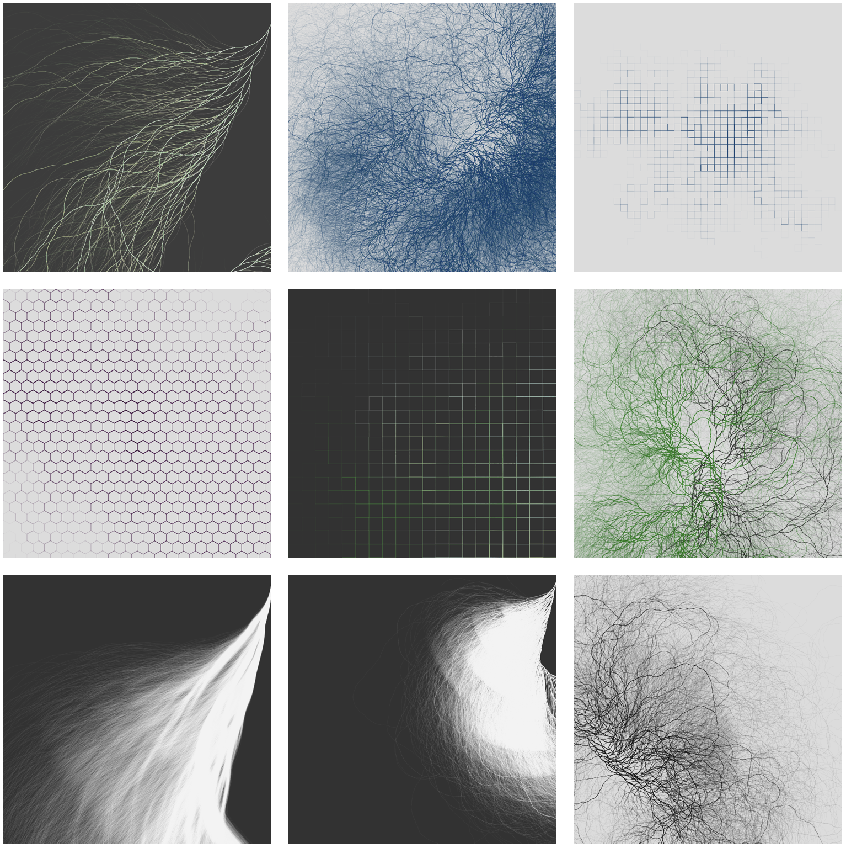
Notes:
https://www.reddit.com/r/processing/comments/dy5z5h/collatz_variations/
https://dailygenerative.art.blog/2019/11/17/reflections/

Slide 4
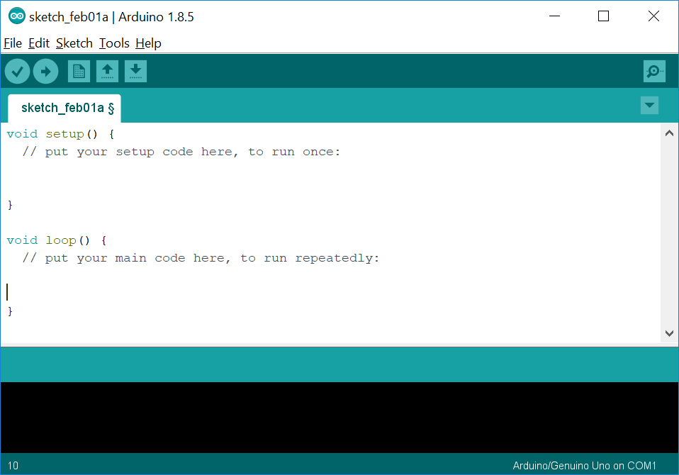
Programming Arduino!
Arduino Programming
All Arduino programs are comprised of two areas: setup and loop.
setup
Called once at the very beginning of execution. Use this for initialization
Loop
Called over and over again as fast as possible by the microcontroller. As soon as your code completes here, loop() will be called again forever

Slide 5
Programming Arduino!
Arduino Programming
All Arduino programs are comprised of two areas: setup and loop.
Does this overall structure with setup and loop look familiar?
setup
Called once at the very beginning of execution. Use this for initialization
Loop
Called over and over again as fast as possible by the microcontroller. As soon as your code completes here, loop() will be called again forever

Slide 6
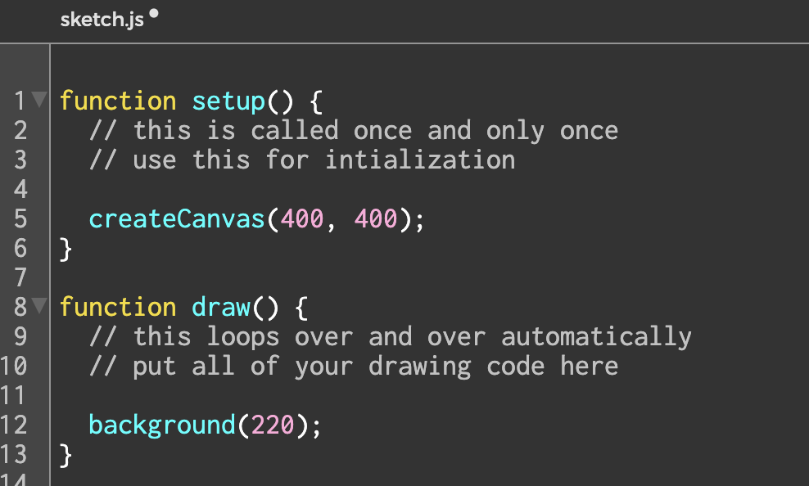
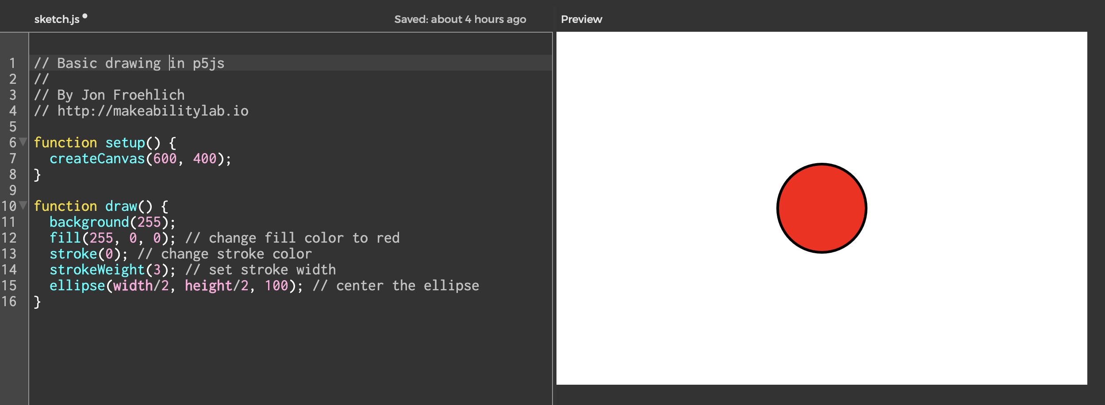
It’s the same as the Processing/p5js structure
Arduino Programming
setup
Called once at the very beginning of execution. Use this for initialization
Draw
Called over and over again at 60 frames per second. You can change the framerate by calling frameRate(newFrameRateVal).

Slide 7
It’s the same as the Processing/p5js structure
Arduino Programming
setup
Called once at the very beginning of execution. Use this for initialization
Draw
Called over and over again at 60 frames per second. You can change the framerate by calling frameRate(newFrameRateVal).

Slide 8
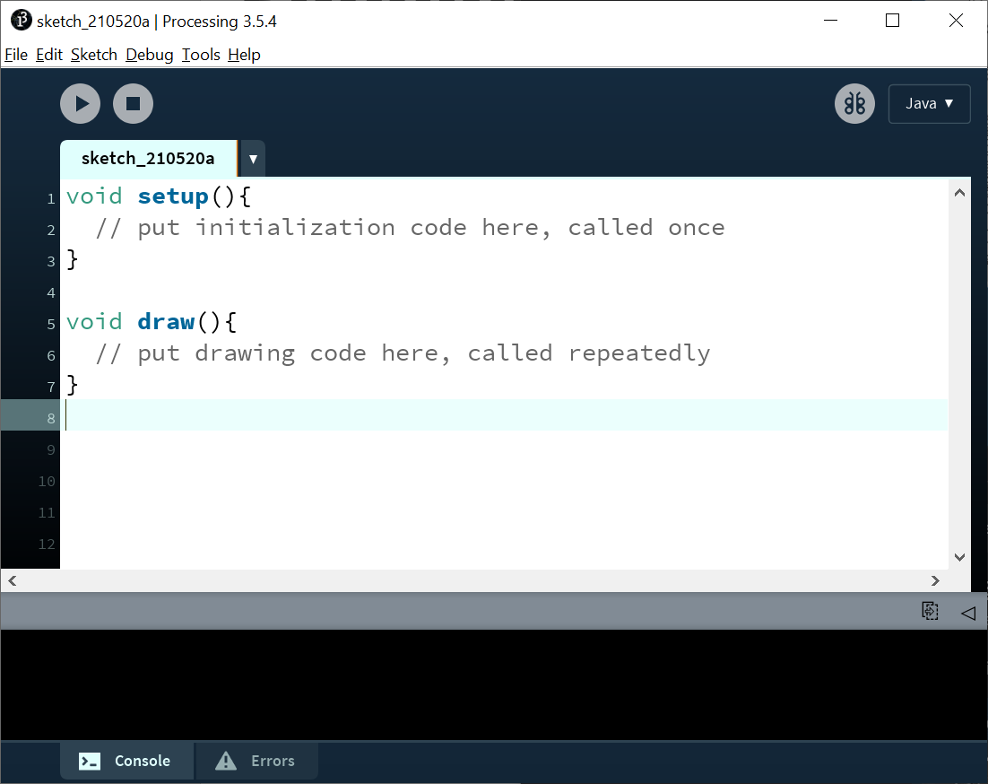
setup
Called once at the very beginning of execution. Use this for initialization
DRAW
TODO

Slide 9
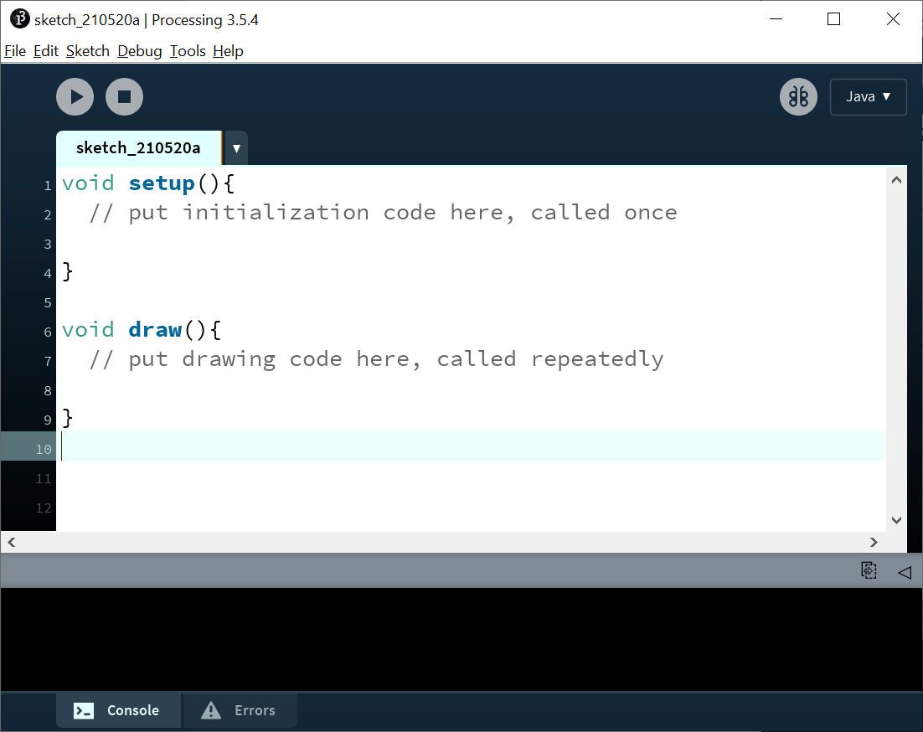
setup
Called once at the very beginning of execution. Use this for initialization
DRAW
Called repeatedly in a loop() at 60 frames per second (the default, which can be changed with the framerate function)

Slide 10
setup
Called once at the very beginning of execution. Use this for initialization
DRAW
Called repeatedly in a loop() at 60 frames per second (this can be changed with frameRate() function)

Slide 11
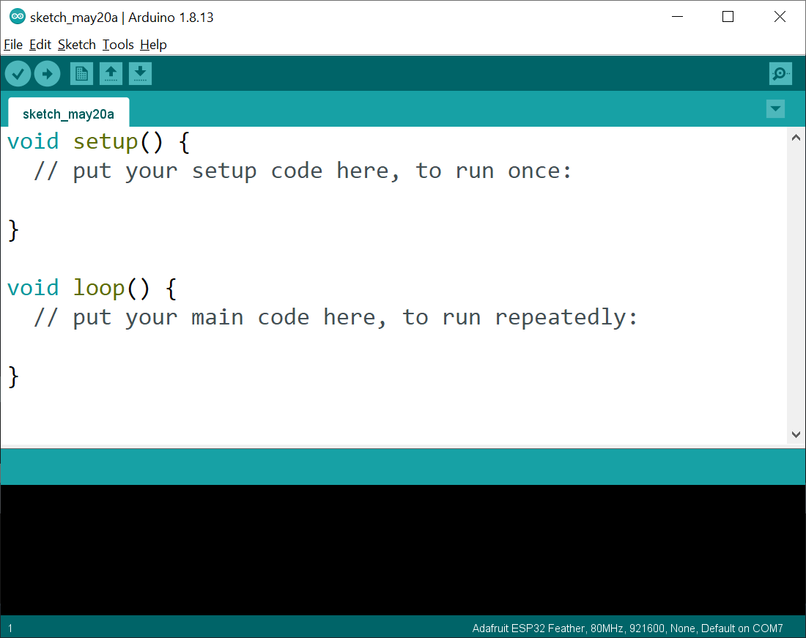
setup
setup
Called once at the very beginning of execution. Use this for initialization
Called once at the very beginning of execution. Use this for initialization
DRAW
Loop
Called repeatedly in a loop() at 60 frames per second (this can be changed with frameRate() function)
Called over and over again as fast as possible by the microcontroller. As soon as your code completes here, loop() will be called again forever.
OUTPUT CONSOLE
OUTPUT
See errors and printlns from program
For compilation/uploading output

Slide 12
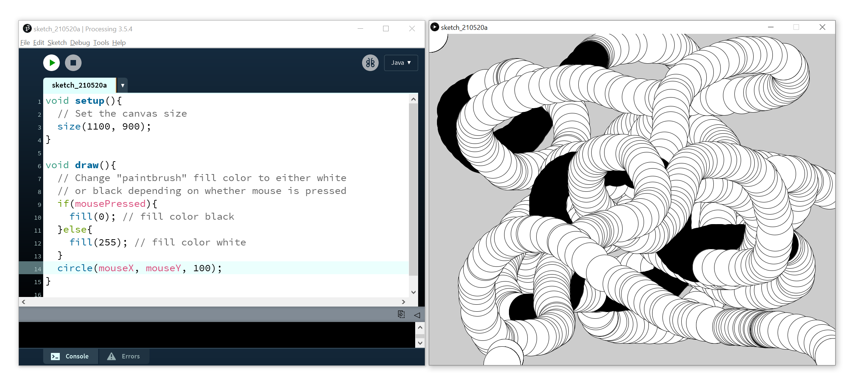

Slide 13
